Slide 1
Python Crash Course
09 January 2023
Lesson 1

Slide 2
About me:
Accenture Chair 2020 alumnus
Senior FP&A Analyst at Campari
Focus on: Corporate Finance and Data Analytics
Founder @ Exibero
Taught last 2 Python Crash Courses
Linkedin: https://www.linkedin.com/in/lorenzo-cerreta/
Email: b00758824@essec.edu / lorenzo.cerreta@gmail.com

Slide 3
Syllabus:
Slot 1 (Jan 8) – Introduction:
data types (ints, floats, strings, bools)
conditionals
Slot 2 (Jan 9) – «guess a number» game:
data types (list, dict)
loops
Slot 3 (Jan 11) – «what’s your favourite tv series» game:
functions
Slot 4 (Jan 14) – web scraping for wines:
connecting to a website
downloading data

Slide 4
The course:
If you need the basics: follow the lessons and acquire the skills required from the Chair
If you are intermediate: complete the «FeelBored» exercises and get feedback (come back for lesson 4)
Material:
Based, with minor changes, on Jerry Pussinen (2018), Learn Python 3.
A few requests:
Turn camera on
Try to do as many exercises as possible
Ask questions / feedback
Complete a short questionnaire using only your knowledge
https://forms.gle/7jn2jySb7zjjYYCq6

Slide 5
Installing Python
On Mac, Python2 or 3 are likely already installed. DO NOT UNINSTALL them, or you might break your Mac! You still need to install a separate Python3.
Choose one of the suggested installation:
Anaconda (recommended, especially on Windows)
Miniconda (if you either have little space on your PC or you know how to use the terminal in place of a GUI)
Python.org (Vanilla Python) (not particularly recommended)
Google Colab (no installation). You can run the first notebook with this link

Slide 6
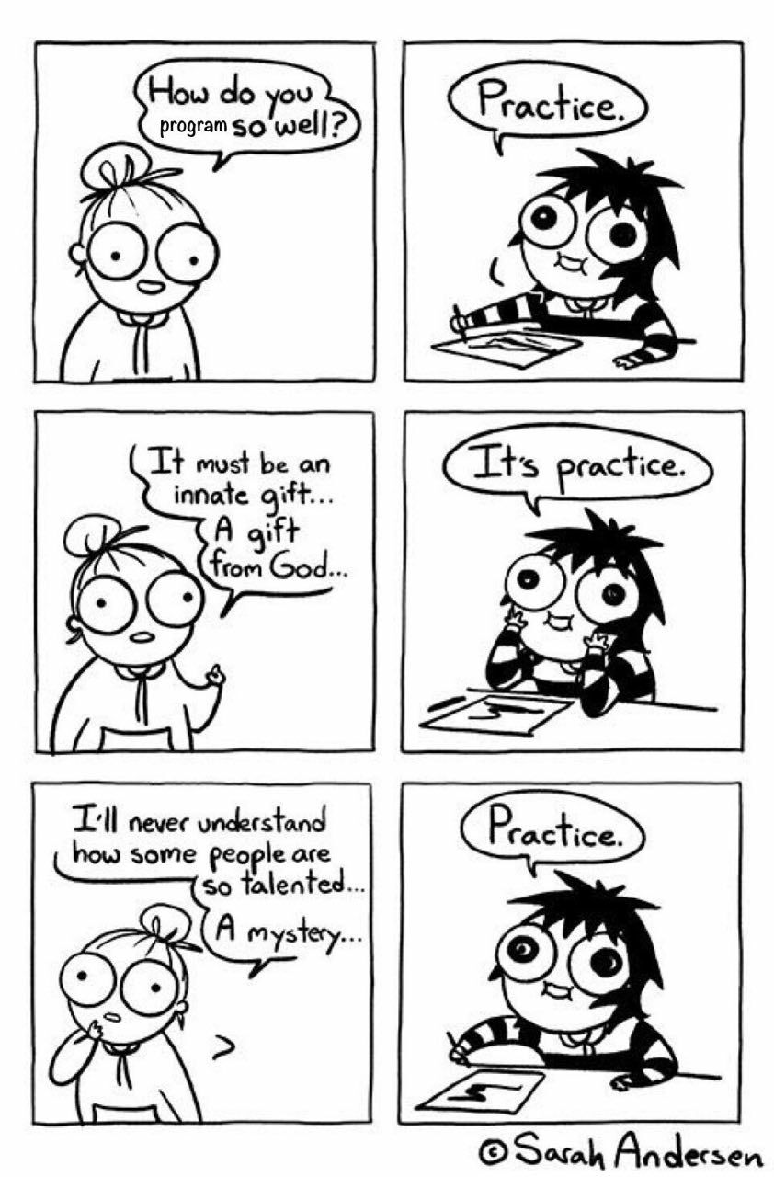

Slide 7
Course Materials
Course Materials will be available on Github (Github is to programmers something like Wikipedia + Google Docs): https://github.com/ElLorans/PythonCrashCourse
You will find a folder with the notebooks we will show in class and a folder named «exercises». If «JupyterExercises» and «PyExercises» are too easy for you, feel free to try the «FeelBored» folder.
If you want to ask a question that can benefit the whole class, please raise an issue on Github.

Slide 8
End of the course
For the next 2 weeks, I will answer questions about exercises at b00758824@essec.edu
Exercises are available at https://github.com/ElLorans/PythonCrashCourse

Slide 9
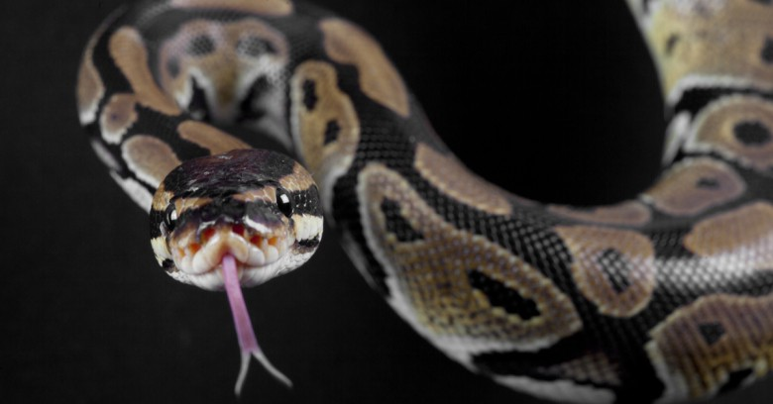
Sorry for the long ppt
Here is a Python

